Slide 1
Introduction to Arduino
Ctrl+Alt+Elite
Notes:
Having the students take notes is recommended.

Slide 2
Introduction to Arduino
We will learn about
The Arduino Uno
The Arduino Uno’s pins and other ports
Delivering Power
The Arduino IDE
Outputs
Inputs
The serial monitor
Notes:
Microcontrollers are used in everything, such as engine control modules, toys, and appliances.
They are very inexpensive and great for specific tasks.

Slide 3
What is a Microcontroller?
A microcontroller is like a small computer
They are typically designed to accomplish a single task
They normally operate without human input, and are used to control other electronics.
Notes:
Microcontrollers are used in everything, such as engine control modules, toys, and appliances.
They are very inexpensive and great for specific tasks.

Slide 4
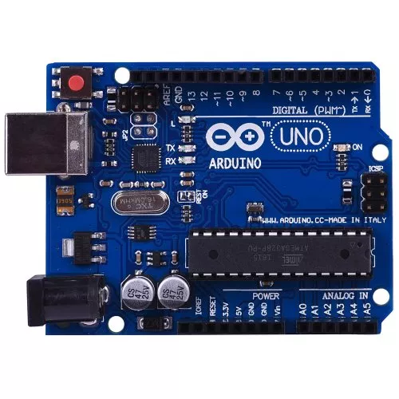
The Arduino Uno
This is an Arduino Uno
It is a microcontroller that is very popular with hobbyists
It is inexpensive
The Arduino Uno has a huge amount of support online to help out!
Notes:
A hobbyist is someone who pursues a particular hobby (https://www.merriam-webster.com/thesaurus/hobbyist)
They cost about 10-20$
Arduinos and their popularity mean that documentation and examples of things people have built with them very common and easy to find.

Slide 5
What kinds of things can we build?
Almost anything!
Notes:
Look online for some examples to show.

Slide 6
Specifics about the Arduino
The Arduino has many parts and components!
But, they are all pretty simple.

Slide 7
The Arduino: Pins and Ports
The Arduino Uno has a variety of ports and pins that can be used.
We are going to cover the most important ones.

Slide 8
The Arduino: Pins and Ports: USB
The Uno has a USB type B port.
This is used to connect to a computer and upload new instructions, or code to the Arduino.

Slide 9
The Arduino: Pins and Ports: Barrel Jack
The barrel Jack is used to connect the Arduino to a power source, such as a 9v battery.
Like how a laptop is plugged in.

Slide 10
The Arduino: Pins and Ports: Ground Pins
The Arduino Uno has three ground pins
These are needed to Complete a circuit!
Notes:
Understanding a basic circuit is important here.

Slide 11
The Arduino: Pins and Ports: Reset Button
The reset button does what it says, resets the Arduino Uno.

Slide 12
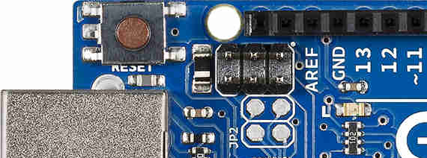
The Arduino: Pins and Ports: The LED
This LED can be controlled by the user
Digital Pin 13, more info on this later.
Notes:
Understanding a basic circuit is important here.

Slide 13
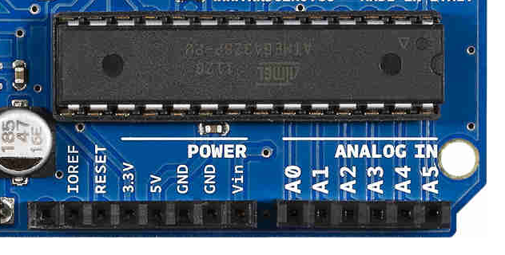
The Arduino: Pins and Ports: Voltage Pins
The 3.3v and 5v pins are used to power external devices
The 5v pin can also be used to power the Arduino itself. This is not recommended, however.
3.3v
5v
Notes:
Understanding a basic circuit is important here.

Slide 14
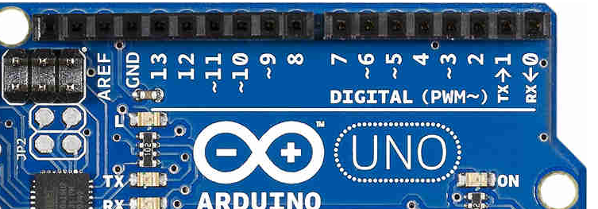
The Arduino: Pins and Ports: Digital Pins
There are 14 digital pins on the Arduino Uno, numbered 0-13.
These pins can be controlled by software, to either on, or off.
They can also be used as inputs.
We will come back to these when we talk about programming the Arduino.
Notes:
These are a huge deal when programming, as they are how the Arduino can control outside devices.
This would be a good place to explain the difference between analog and digital

Slide 15
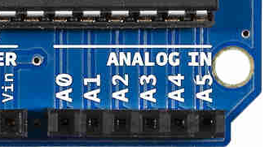
The Arduino: Pins and Ports: Analog Pins
There are 6 analog input pins, numbered A0-A6.
These can read an analog (smooth) signal into the Arduino.
We will come back to these.

Slide 16
The Arduino Uno: Giving it Power pt 1
There are four ways to power an Arduino Uno
The USB jack
The Barrel Jack
The VIN pin
The 5v and Ground pins (Not recommended)

Slide 17
Using the Barrel Jack
The barrel jack is one of the simpler ways to power the Arduino Uno
It can use any source between 7-12 volts.
A 9 volt battery is the most common.

Slide 18
Using the 5V and Ground Pins
You can also power the arduino through the 5V and Ground pins, making a complete circuit.
This only works with a 5v supply, higher can kill the Arduino
This is rarely used.

Slide 19
Using the VIN pin
You can use the VIN and Ground pins as another way to power the Arduino Uno
This uses between 7 and 12 volts
A 9v battery is recommended and common

Slide 20
The USB port
Finally, the Arduino Uno has a USB type B input.
This can be connected to a computer, such as a laptop to deliver power.

Slide 21
How do we control the Arduino?
Now that we know what pins the arduino has, how do we control them?
With Code!
But we need a way to get code from the computer to the Arduino
This is one of the uses for the USB Cable

Slide 22
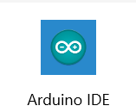
The Arduino IDE
You can open the IDE by clicking on the icon that looks like the one to the side.
It should be on your desktop
If not, you can find it by pressing the windows key, and typing “Arduino IDE”

Slide 23
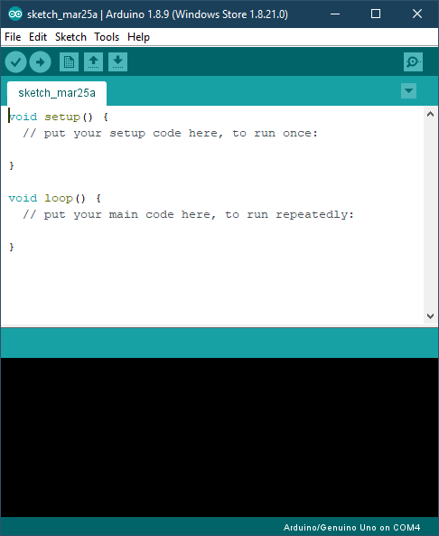
The Arduino IDE
Here is what it looks like once you open the IDE.
This is a new file, but there are a few things we need to do before we can upload code to the UNO.

Slide 24
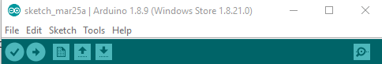
The Arduino IDE: Setting Up.
There are only two settings that need to be changed or checked.
They are both under Tools on the ribbon.
Notes:
Demonstrate how to do this.

Slide 25
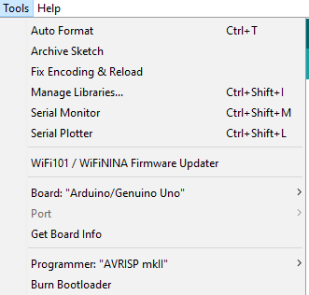
The Arduino IDE: Setting Up.
Check that Arduino/Genuino Uno is the selected board.

Slide 26
The Arduino IDE: Setting Up.
Check the port settings, and make sure the board you are using is selected.

Slide 27

The Arduino IDE: Important Buttons
Verify: This is used to make sure your code is correct, it will tell you about any errors.
Upload: This button checks and then uploads code to the Arduino, if there are no errors.
New: This opens a new file
Open: This opens an existing file
Save: This saves the current file
1 2 3 4 5

Slide 28
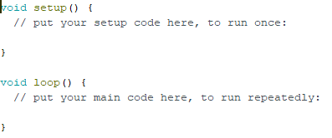
The Arduino IDE: Setup and Loop
There are two functions within a new file that are important to understand.
setup
loop

Slide 29
The Arduino IDE: Setup
The loop function contains code that is only run once, when the Arduino first powers on.

Slide 30
The Arduino IDE: Loop
The setup function contains code that run over and over. This is where code that makes decisions goes.

Slide 31
Programming the Arduino Uno
To program the Uno, we need to know the commands it uses
Luckily, you can do a great many things with only some basic commands, and control logic.

Slide 32
Pinmode and Input vs Output
What is an Input or an Output?
An input is getting information
You listening to us teach is you getting input
It means that Information is going IN
An output is giving out information
Us teaching is us giving output.
Information is coming OUT

Slide 33
Pinmode and Input vs Output
The first basic command is
pinMode(arg1, arg2);
Arg1 is a pin number
Arg 2 is either INPUT or OUTPUT
What arguments you use depends on what you need.
We are telling each pin what to expect.

Slide 34
Pinmode and Input vs Output
For example, if we wanted to use pin 13 as an Input, we would type pinMode(13, INPUT);
What if we wanted pin 11 as an output?
pinMode(12, OUTPUT);
What would we do if we wanted to use pin 3 as an input? What about as an output?

Slide 35
Pinmode and Input vs Output
The pinMode command only needs to be run once per pin.
So, What function would this go in? Setup or loop?
Notes:
It goes in setup

Slide 36
Pinmode and Input vs Output
The pinMode command only need to be run once per pin.
So, What function would this go in? Setup or loop?
void setup() {
// put your setup code here, to run once:
pinMode(12, OUTPUT)
}
Notes:
It goes in setup

Slide 37
A note about pins and variables
It is worth noting that a pin number, since it is just that, a number, can be stored in a variable of type int
int led_pin = 13;
pinMode(led_pin, INPUT);
In fact, using variables to refer to pins is recommended.

Slide 38
digitalWrite
Now, let’s introduce the second basic command, digitalWrite(arg1, arg2);
Arg1 is a digital pin number, 0-13
Arg2 is the keyword HIGH or LOW
Think of this like a light switch, where HIGH means on, and LOW means off.
This lets us control things, like and LED!

Slide 39
digitalWrite
If we wanted to turn pin 12 on, we would use digitalWrite(13, HIGH); and digitalWrite(13, LOW); to turn it off.
Remember variables!
int led_pin = 13;
digitalWrite(led_pin, HIGH);
This can go in either setup or loop, depending on needs

Slide 40
Delay
The delay(arg1); command is very simple, it makes the arduino wait
Arg1 is an amount of Milliseconds
1 millisecond is 1/1000th of a second
So to make the arduino wait 1 second, we would use delay(1000);

Slide 41
A blinking LED
For this small project, let's make the arduino blink its onboard led, which is controlled by any command that controls pin 13, blink.
Stays on for one second, then off for 1, repeat.
Notes:
Walk through this with students. Project the IDE up, and type their suggestions, explaining and correcting incorrect ones.
Show them the correct code.
A solution to this is built into the IDE, under files->examples->blink

Slide 42
A blinking LED
Modify the previous example to make the LED only stay off for ½ a second.
Notes:
Still show what they just did, let them copy and modify it on their own machines.

Slide 43
Analog vs Digital
Digital and Analog, in a basic sense, are two different types of information.
Digital information is like a staircase
There are discrete points along it, it is not smooth.
Analog information is like a ramp
It smoothly goes from the base to the top, with no sudden jumps.

Slide 44
Analog vs Digital
The real world is largely analog. The day is more than just “Bright” or “Dark”, there are things in between, a smooth change in brightness throughout the day, or like with a dimmer switch.
Computers, however, are purely digital, they operate exclusively with only “on” or “off”, like a common lightswitch.

Slide 45
PWM and analogWrite
But! Computers can try to “cheat”, using something called Pulse Width Modulation (PWM).
Think of this as the computer rapidly turning the pin on and off, much faster than we can see.
This can be used to “fake” a smooth transition.

Slide 46
PWM and analogWrite
The Arduino has support for PWM.
Some of the digital pins have a ~ next to the number, this means that pin supports PWM
Pins 3,5,6,9,10, and 11 support it.
How do we control PWM?

Slide 47
PWM and analogWrite
We can control PWM with the command analogWrite(arg1, arg2);
Arg1 is a pin that supports PWM (has a ~ next to it)
Arg2 is a number between 0 and 255
0 means all off, and 255 means all on.
This is like deciding how much time the “lightswitch” is on, with 0 bieng never, and 255 being “always”.

Slide 48
PWM Challenge
Use the analogWrite(arg1, arg2); and the delay(arg1); commands to make an LED on pin 11 change to three different brightnesses every 1/4th of a second, and repeat.
You can connect the LED directly to 11 and the nearby ground.
Remember, the long leg goes to ground.
Notes:
They can use the last one as a base, and it may help to walk through this, as needed.
The solution is in the file “PWM_LED”

Slide 49
Inputs
Now you should understand how outputs from the Arduino work, so let’s talk about inputs.
There are two types of inputs, just like there are two types of outputs, Digital and Analog.

Slide 50
Digital Read
The command digitalRead(arg1); is used to read in the “state” of one of the digital pins.
Arg1 is a digital pin number
Think of it as checking a light switch and seeing if is on or off.
It returns either HIGH or LOW.

Slide 51
Digital Read
Remember the == operator?
It was used to check if one thing equalled another thing,
3 == 4, FALSE
3==3, TRUE
It was used with if statements,
If (3 == 3) {
//code here
}

Slide 52
Digital Read
We can use digitalRead(arg1); and if statements together
if (digitalRead(13) == HIGH) {
//code here
}

Slide 53
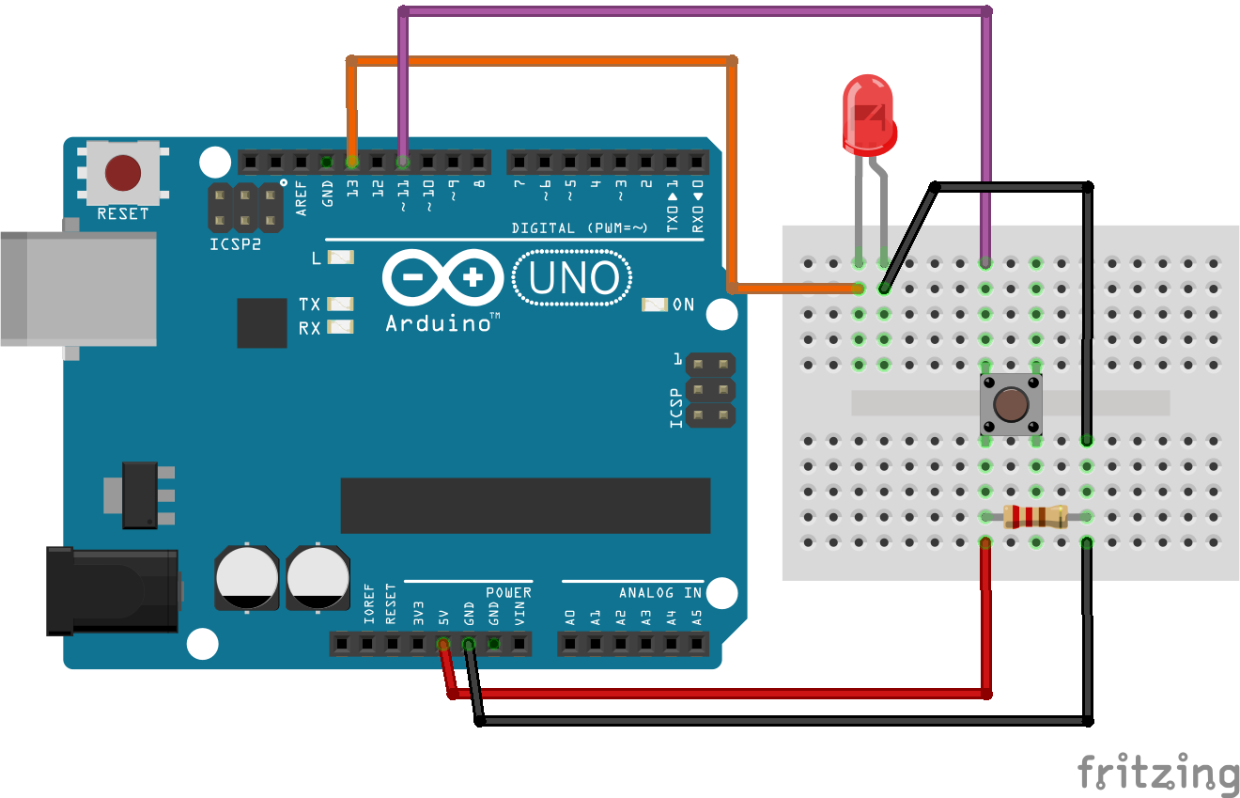
Using DigitalRead
Using the attached wiring diagram, write an arduino program that makes the LED turn on when the button is pressed.
Notes:
Solution is saved as “Digital_Read_Challenge”

Slide 54
AnalogRead
Like how digitalRead(arg1); can be used on the digital pins, the analog pins have their own function, analogRead(arg1);
Arg1 is an analog pin, A0-A5
This returns an integer between 0 and 1023.

Slide 55
AnalogRead
The analog pins work by receiving a voltage between 0v and 5v, and converting that into a number between 0 and 1023.
Like recording how bright it is as a number between 1 and 10
For example, a potentiometer lets through a different amount of voltage based on what position it is in.
Notes:
Remind then what a potentiometer is, if needed.

Slide 56
AnalogRead
We can use analogRead(arg1); and if statements together
if (analogRead(A0) > 512) {
//code here
}

Slide 57
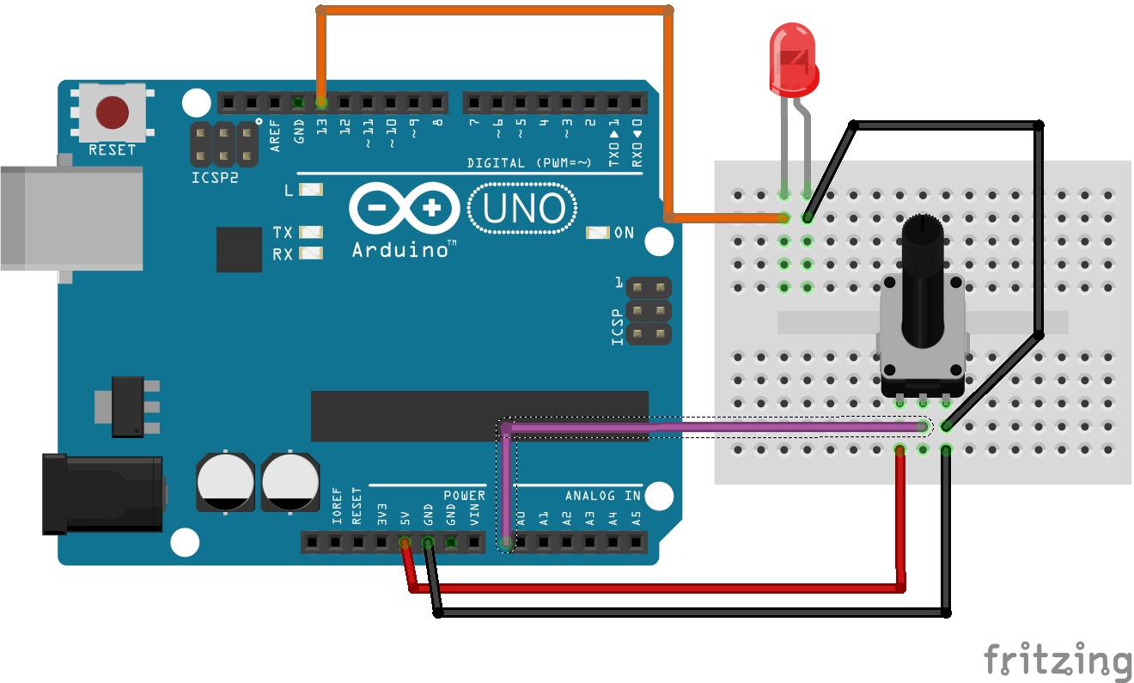
Analog Read Challenge
Using the attached wire diagram, make a program that changes the brightness of the LED based on the potentiometers position.
Notes:
Solution is “AnalogRead_Challenge”

Slide 58
Getting information out of the Arduino
There another thing you need to know how to do, get information out of the Arduino in as easy to read way

Slide 59

The Serial Monitor
The arduino has a serial monitor, it is a place where the arduino can print out text and such for us to read.
You can open it by clicking the magnifying glass in the top right corner.

Slide 60
The Serial Monitor
But, how do we use it?
There are several steps to using the serial monitor, but they are all very simple.
First, you place Serial.begin(arg1); in the setup function
Arg1 is the rate at which information is transmitted, 9600 is the most common.

Slide 61
The Serial Monitor
Then we use Serial.print(arg1); to print information to the monitor.
Arg1 is what we want to print
Text in the for “text we want to print”
A variable, such as led_pin
A function, such as analogRead(arg1);
Or ‘\n’ which print a newline, like hitting enter in a word document.

Slide 62
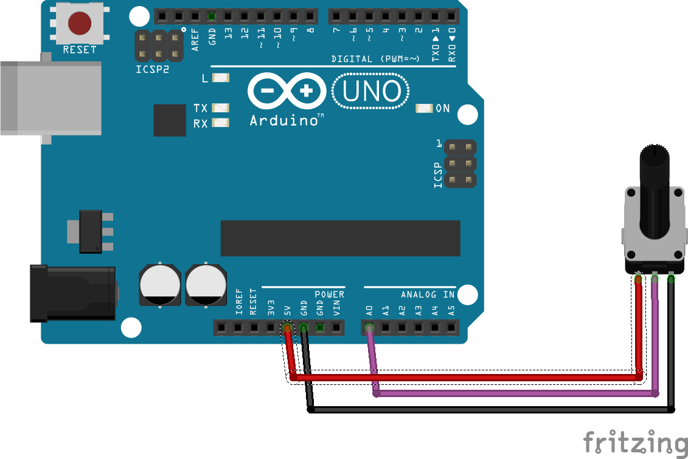
Serial Monitor Challenge
Using the attached diagram, make the arduino print out the value of analogRead(arg1); on the potentiometer.
Notes:
Solution is under “SerialMonitor Challenge”

